Slide 1
Assessing Lovoo’s VIP Membership Status

Slide 2
Issue Tree Template
STRUCTURED FOUNDATIONS
Developing a profile
VIP
How can Lovoo promote its VIP memberships by 25% this year, especially among those who fit the VIP profile
Key characteristics
Identifying key characteristics that match the profile of the VIP
New entrants
Non-VIP
Identify candidates from among new entrants and existing customers
Existing Customers
H
D
E
I
P

Slide 3
Problem Statement
How can Lovoo promote its VIP memberships by 25% this year, especially among those who fit the VIP profile?
S - Focusing on promoting its VIP memberships by 25%
M - 25%
A - promote existing and new premium memberships
R- relevant to the data
T-this year

Slide 4
We chose not to focus on gender

Slide 5
How do certain Non-VIPs resemble a VIP?
age | counts_pictures | counts_profileVisits | counts_kisses | counts_fans | distance | isFlirtstar | isHighlighted | isInfluencer | isMobile | isOnline | isVip | lang_count | verified | shareProfileEnabled
21.59 | 6.97 | 4939.97 | 220.87 | 2.43 | 172.73 | 0.02 | 0.02 | 0 | 0.82 | 0.45 | 1 | 1.26 | 0.38 | 0.94

Slide 6
Structured Approach
We first focused on VIPs, developing a profile
VIP's are younger, have more pictures, have more profile visits, more kisses, more fans, shorter distance, more Flirtstars, are highlighted more, are less often New Users, speak more languages, are verified more often and have more private profiles.
 | age | counts_pictures | counts_profileVisits | counts_kisses | counts_fans | distance | isFlirtstar | isHighlighted | isInfluencer | isMobile | ... | isOnline | isVip | lang_count | verified | shareProfileEnabled | lastOnlineTime | birthd | crypt | isSystemProfile | index1
count | 91 | 91 | 91 | 91 | 91 | 91 | 91 | 91 | 91 | 91 | ... | 91 | 91 | 91 | 91 | 91 | 9.10E+01 | 91 | 0 | 0 | 91
mean | 21.593407 | 6.978022 | 4939.978022 | 220.879121 | 2.43956 | 172.730769 | 0.021978 | 0.021978 | 0 | 0.824176 | ... | 0.450549 | 1 | 1.263736 | 0.384615 | 0.945055 | 1.43E+09 | 0 | NaN | NaN | 1305.043956
std | 2.102792 | 6.406556 | 7320.79408 | 520.092061 | 7.041478 | 512.295702 | 0.147424 | 0.147424 | 0 | 0.38278 | ... | 0.500305 | 0 | 0.800488 | 0.4892 | 0.229135 | 4.73E+05 | 0 | NaN | NaN | 879.109839
min | 19 | 0 | 22 | 0 | 0 | 0 | 0 | 0 | 0 | 0 | ... | 0 | 1 | 1 | 0 | 0 | 1.43E+09 | 0 | NaN | NaN | 44
25% | 19.5 | 3 | 1280.5 | 33 | 0 | 0 | 0 | 0 | 0 | 1 | ... | 0 | 1 | 1 | 0 | 1 | 1.43E+09 | 0 | NaN | NaN | 630
50% | 22 | 5 | 2679 | 81 | 0 | 129 | 0 | 0 | 0 | 1 | ... | 0 | 1 | 1 | 0 | 1 | 1.43E+09 | 0 | NaN | NaN | 1171
75% | 23 | 9 | 5489.5 | 172.5 | 1 | 178.5 | 0 | 0 | 0 | 1 | ... | 1 | 1 | 1 | 1 | 1 | 1.43E+09 | 0 | NaN | NaN | 1868.5
max | 26 | 30 | 51809 | 4114 | 36 | 4880 | 1 | 1 | 0 | 1 | ... | 1 | 1 | 5 | 1 | 1 | 1.43E+09 | 0 | NaN | NaN | 3925

Slide 7
Structured Approach
We then focused on Non-VIPs
 | age | counts_pictures | counts_profileVisits | counts_kisses | counts_fans | distance | isFlirtstar | isHighlighted | isInfluencer | isMobile | ... | isOnline | isVip | lang_count | verified | shareProfileEnabled | lastOnlineTime | birthd | crypt | isSystemProfile | index1
count | 3901 | 3901 | 3901 | 3901 | 3901 | 3855 | 3901 | 3901 | 3901 | 3901 | ... | 3901 | 3901 | 3901 | 3901 | 3901 | 3.90E+03 | 3901 | 46 | 2 | 3901
mean | 22.000769 | 4.735452 | 3676.669316 | 155.100231 | 2.332992 | 208.044384 | 0.011536 | 0.011536 | 0 | 0.744168 | ... | 0.588567 | 0 | 1.106127 | 0.216098 | 0.961036 | 1.43E+09 | 0.003845 | 1 | 1 | 2011.606511
std | 1.955334 | 4.351156 | 6831.884617 | 373.64017 | 12.331307 | 182.768339 | 0.106796 | 0.106796 | 0 | 0.436384 | ... | 0.492156 | 0 | 0.576031 | 0.411635 | 0.193535 | 8.14E+05 | 0.061898 | 0 | 0 | 1153.306006
min | 18 | 0 | 0 | 0 | 0 | 0 | 0 | 0 | 0 | 0 | ... | 0 | 0 | 0 | 0 | 0 | 1.43E+09 | 0 | 1 | 1 | 0
25% | 20 | 2 | 375 | 11 | 0 | 86.15 | 0 | 0 | 0 | 0 | ... | 0 | 0 | 1 | 0 | 1 | 1.43E+09 | 0 | 1 | 1 | 1013
50% | 22 | 4 | 1190 | 43 | 0 | 173 | 0 | 0 | 0 | 1 | ... | 1 | 0 | 1 | 0 | 1 | 1.43E+09 | 0 | 1 | 1 | 2023
75% | 24 | 6 | 4033 | 140 | 0 | 319 | 0 | 0 | 0 | 1 | ... | 1 | 0 | 1 | 0 | 1 | 1.43E+09 | 0 | 1 | 1 | 3011
max | 28 | 30 | 164425 | 9288 | 241 | 6918 | 1 | 1 | 0 | 1 | ... | 1 | 0 | 9 | 1 | 1 | 1.43E+09 | 1 | 1 | 1 | 3991

Slide 8
Data Cleansing
Removing columns ‘count_g’ and ‘count_details’

Slide 9
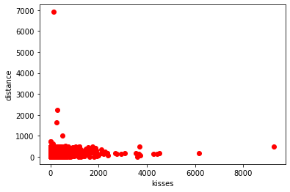
Non-VIPs kisses vs. distance

Slide 10
Non-VIP profile
 | age | counts_pictures | counts_profileVisits | counts_kisses | counts_fans | distance | isFlirtstar | isHighlighted | isInfluencer | isMobile | ... | isOnline | isVip | lang_count | verified | shareProfileEnabled | lastOnlineTime | birthd | crypt | isSystemProfile | index1
count | 3901 | 3901 | 3901 | 3901 | 3901 | 3855 | 3901 | 3901 | 3901 | 3901 | ... | 3901 | 3901 | 3901 | 3901 | 3901 | 3.90E+03 | 3901 | 46 | 2 | 3901
mean | 22.000769 | 4.735452 | 3676.669316 | 155.100231 | 2.332992 | 208.044384 | 0.011536 | 0.011536 | 0 | 0.744168 | ... | 0.588567 | 0 | 1.106127 | 0.216098 | 0.961036 | 1.43E+09 | 0.003845 | 1 | 1 | 2011.606511
std | 1.955334 | 4.351156 | 6831.884617 | 373.64017 | 12.331307 | 182.768339 | 0.106796 | 0.106796 | 0 | 0.436384 | ... | 0.492156 | 0 | 0.576031 | 0.411635 | 0.193535 | 8.14E+05 | 0.061898 | 0 | 0 | 1153.306006
min | 18 | 0 | 0 | 0 | 0 | 0 | 0 | 0 | 0 | 0 | ... | 0 | 0 | 0 | 0 | 0 | 1.43E+09 | 0 | 1 | 1 | 0
25% | 20 | 2 | 375 | 11 | 0 | 86.15 | 0 | 0 | 0 | 0 | ... | 0 | 0 | 1 | 0 | 1 | 1.43E+09 | 0 | 1 | 1 | 1013
50% | 22 | 4 | 1190 | 43 | 0 | 173 | 0 | 0 | 0 | 1 | ... | 1 | 0 | 1 | 0 | 1 | 1.43E+09 | 0 | 1 | 1 | 2023
75% | 24 | 6 | 4033 | 140 | 0 | 319 | 0 | 0 | 0 | 1 | ... | 1 | 0 | 1 | 0 | 1 | 1.43E+09 | 0 | 1 | 1 | 3011
max | 28 | 30 | 164425 | 9288 | 241 | 6918 | 1 | 1 | 0 | 1 | ... | 1 | 0 | 9 | 1 | 1 | 1.43E+09 | 1 | 1 | 1 | 3991

Slide 11
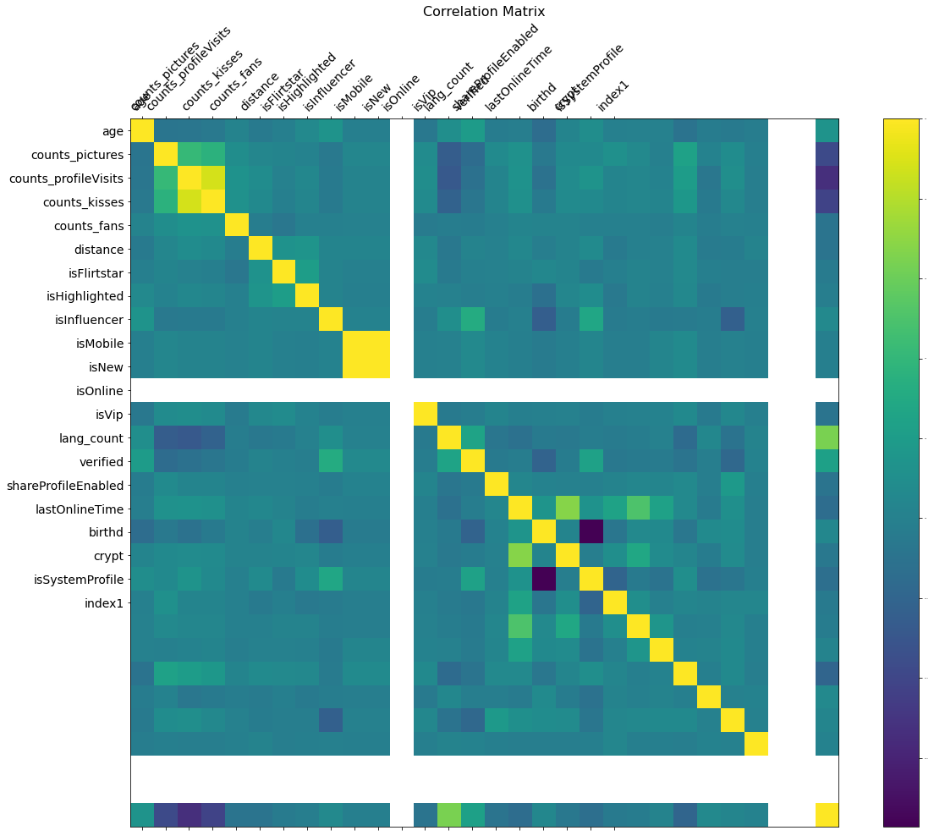
Correlation

Slide 12
Code for correlation
f = plt.figure(figsize=(19, 15))
plt.matshow(cleaned.corr(), fignum=f.number)
plt.xticks(range(cleaned.select_dtypes(['number']).shape[1]), cleaned.select_dtypes(['number']).columns, fontsize=14, rotation=45)
plt.yticks(range(cleaned.select_dtypes(['number']).shape[1]), cleaned.select_dtypes(['number']).columns, fontsize=14)
cb = plt.colorbar()
cb.ax.tick_params(labelsize=2)
plt.title('Correlation Matrix', fontsize=16);
plt.show()

Slide 13
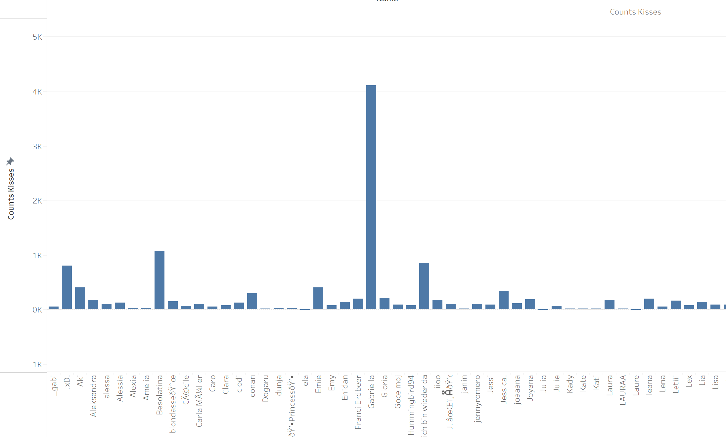
Simulation
3992 trials
Randomly sampling from the VIP kisses distribution
222.3 > 155.1

Slide 14
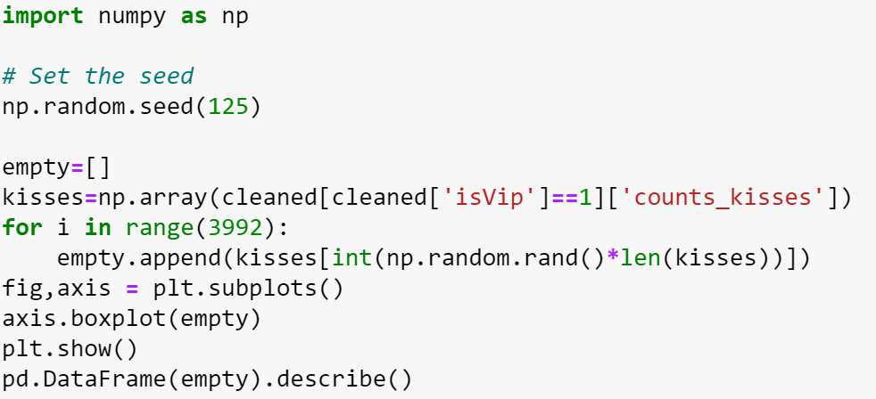
Code for simulation

Slide 15
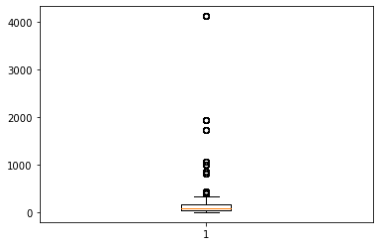
Box and whisker plot

Slide 16
VIPs are highlighted more often resulting in more profile views
count | 3992.000000
mean | 0.018036
std | 0.133098

Slide 17
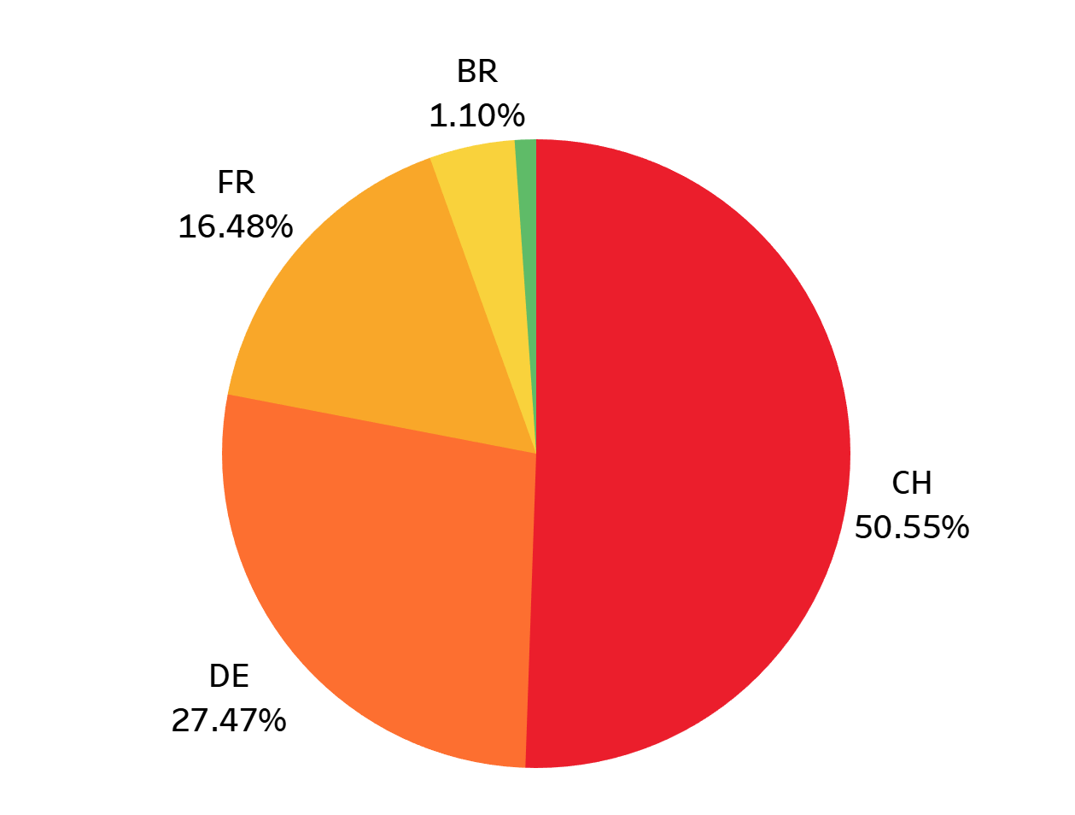
The vast majority of users are from Europe

Slide 18
New entrants
New users that have age below the 45th percentile, count of pictures above the 80th percentile, profile visits about the 79th percentile, and kisses above the 83rd percentile are expected to become VIP users
The VIP purchase rate can get as low as 0.21% with new users.

